Slide 1
Flour
Sugar
Eggs
Bake
Chocolate Chip Cookies
Chocolate Chips
Baking Powder
Margarine
vanilla

Slide 2
Flour
Sugar
vinegar
Bake
Chocolate cake
cocoa
Baking Soda
oil
vanilla

Slide 3
Chocolate Chip Cookies
Mass of ingredient
Flour
Sugar
Eggs
Margarine
Vanilla
Chocolate Chips
Baking Powder

Slide 4
440Hz
880Hz
1320Hz
Trumpet A
1760Hz
2200Hz
2640Hz
3080Hz

Slide 5
440Hz
1320Hz
Clarinet A
2200Hz
3080Hz

Slide 6
Trumpet A
Amplitude of Partial
440Hz
880Hz
1320Hz
2640
3080
1760Hz
2200Hz

Slide 7
Clarinet A
Amplitude of Partial
440Hz
880Hz
1320Hz
2640
3080
1760Hz
2200Hz

Slide 10
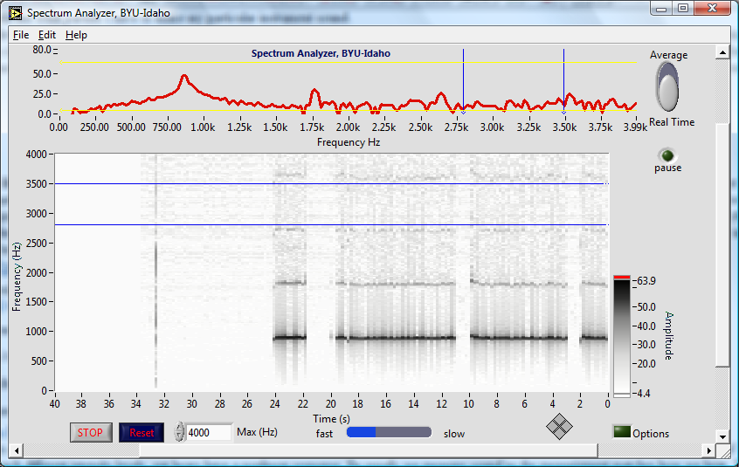
Peaks show partials

Slide 11
Strip chart also shows partials, darker black means higher peak
It is like looking at the graph above, but from above, and repeated for each second of playing

Slide 12
Notice that there are non-harmonic partials in this instrument too!

Slide 13
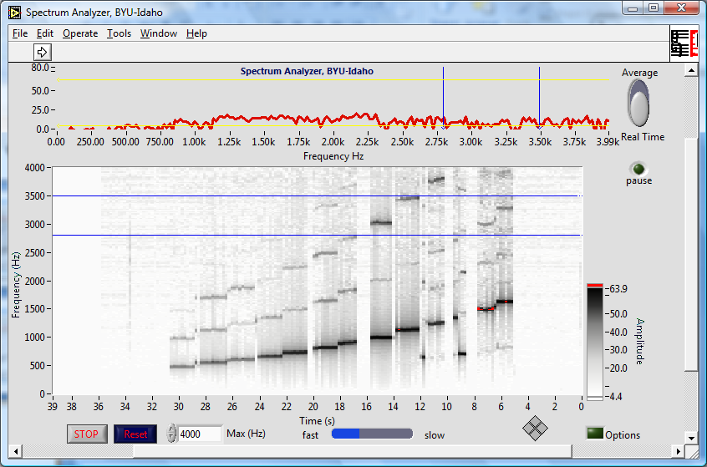
Bamboo six holed flute

Slide 14
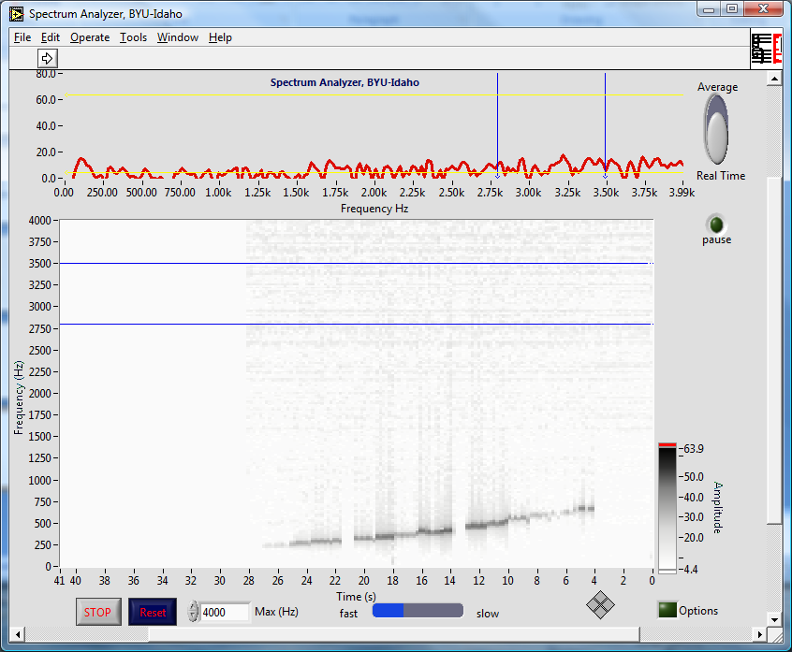
Ocarina

Slide 15
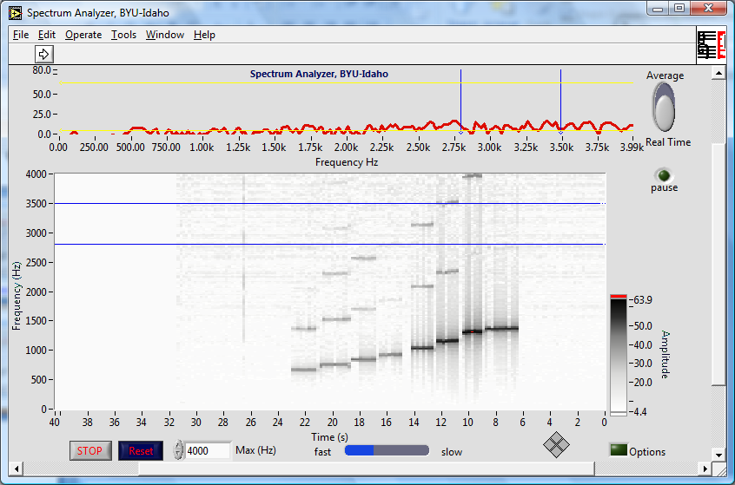
Recorder

Slide 16
Recorder

Slide 17
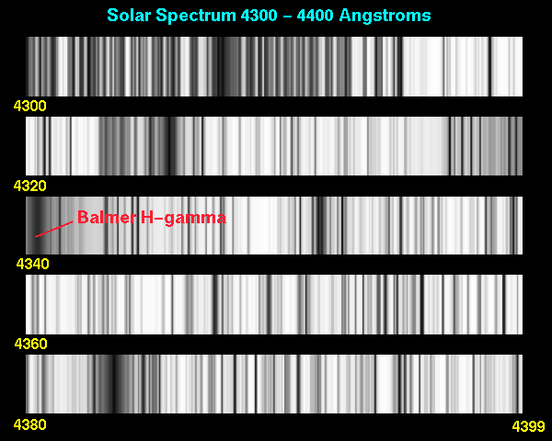
Application: Light Spectra

Slide 18


Slide 19
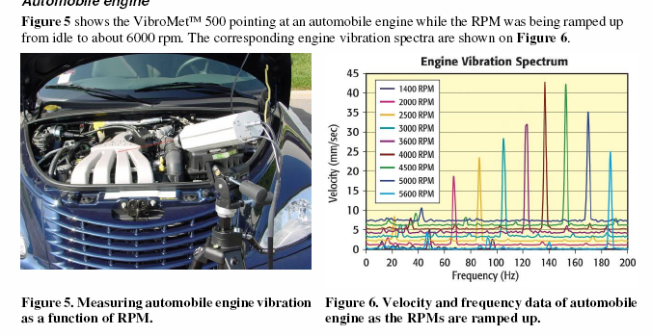
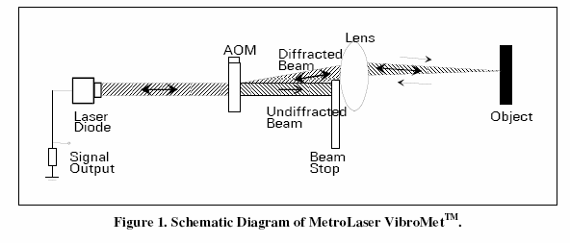
Application: Industrial Monitoring

Slide 20
Application, Vibrometry Target ID

Slide 21
Example: Square Wave

Slide 22
Example: Square Wave

Slide 23
Example: Square Wave, More Terms

Slide 24
Example: Square Wave

